Slide 1
Kokoleoko
Western African Folk Song

Slide 2
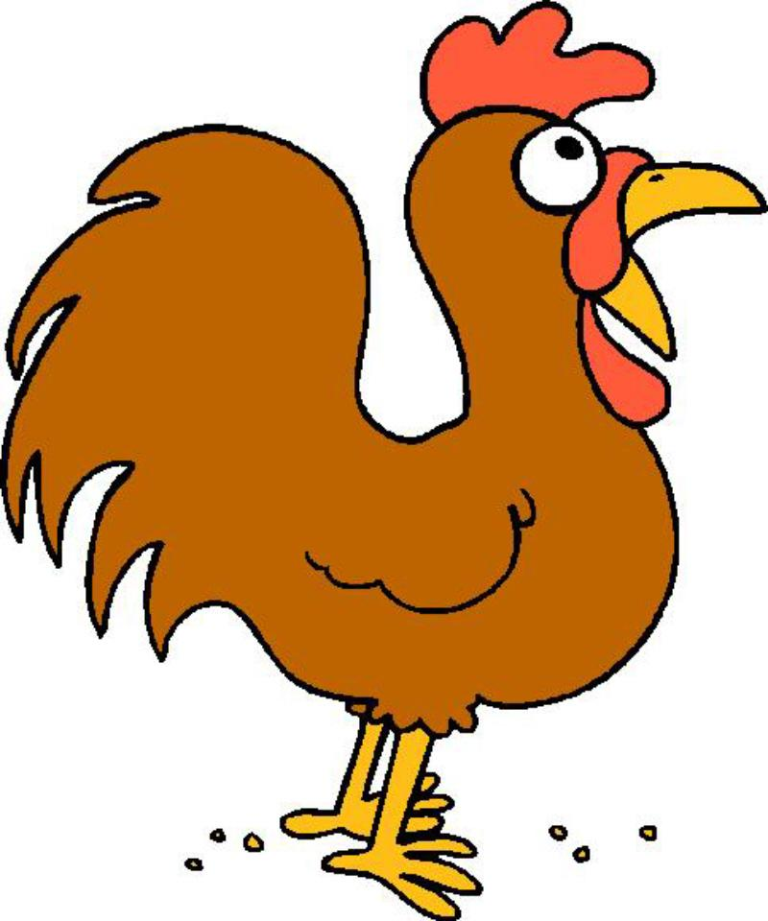
Kokoleoko mama koleoko
Kokoleoko mama koleoko
Aba mama aba
Aba mama koleoko

Slide 3
Pat the beat
Ko - ko - le - o - ko ma - ma ko - ko - le – o - ko
Ko – ko – le – o - ko ma - ma ko - le - o - ko

Slide 4
A – ba ma – ma a - ba
A - ba ma - ma ko - le o - ko

Slide 5
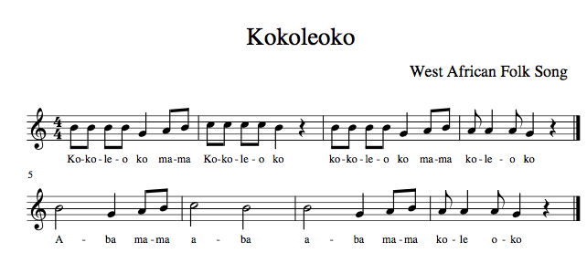

Slide 6
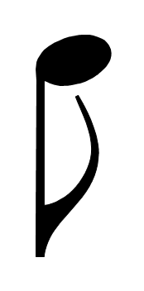




Drag the correct pitches and rhythm of our song

Slide 7
Drag the correct pitches and rhythm of our song

Slide 8
Drag the correct pitches and rhythm of our song

Slide 9
Drag the correct pitches and rhythm of our song

Slide 10
Drag the correct pitches and rhythm of our song

Slide 11
Drag the correct pitches and rhythm of our song

Slide 12
Drag the correct pitches and rhythm of our song

Slide 13
Drag the correct pitches and rhythm of our song

